Slide 1
EN 410 Energy Management
Gurubalan Annadurai
guru.a@iitb.ac.in

Slide 2
Recap
Global and Indian energy scenario
Energy security
Necessity of energy management

Slide 3
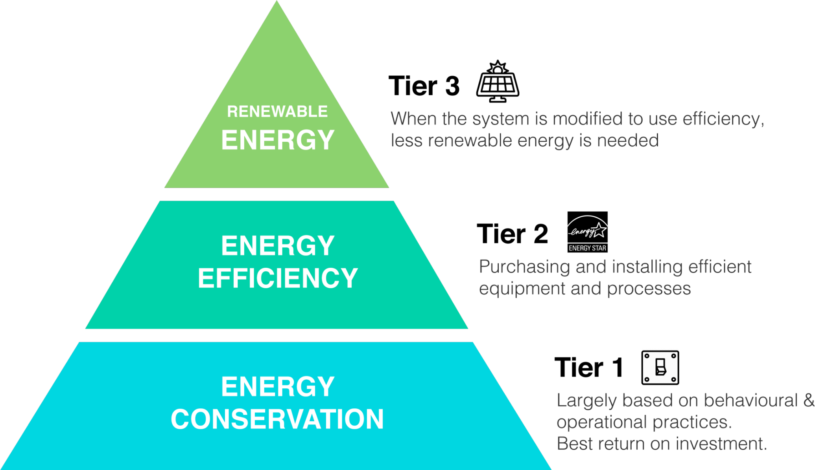
Energy Pyramid

Slide 4
Energy Management
Objective
The judicious and effective use of energy to maximize profits (minimize costs) and enhance competitive positions
Benefits
Reduce the greenhouse gases and improving air quality
Improving the national energy security index
Reduce the impact of brownouts or interruption in supplies

Slide 5
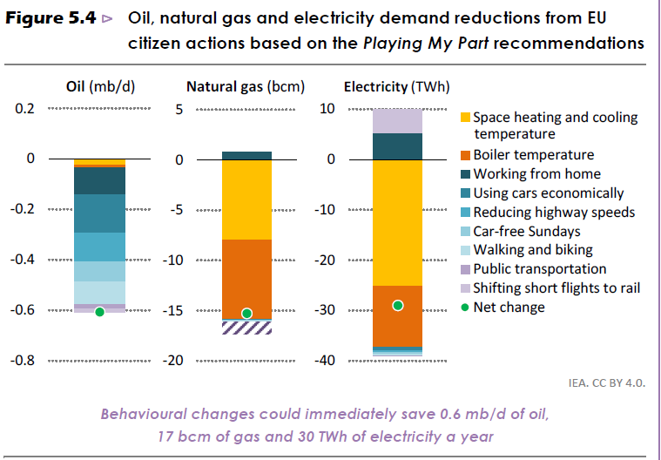
Energy Conservation

Slide 6
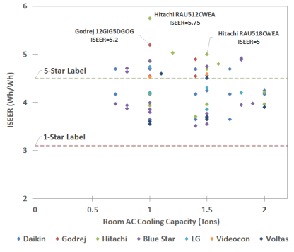
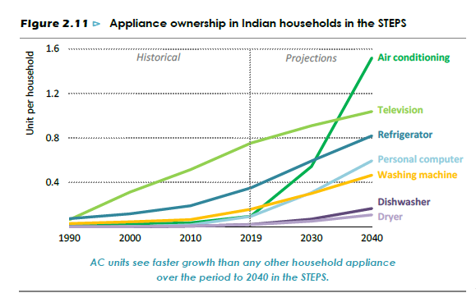
Energy Efficiency - Often considered as an alternative fuel

Slide 7
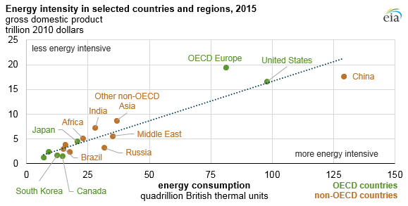
Energy Intensity
Energy intensity is a measure that is often used to assess the energy efficiency of a particular economy
Ratio of energy use to gross domestic product
Low energy intensity is the desired goal
Trying to decouple energy use and economic output to enhance that quality
How will affect our life?

Slide 8
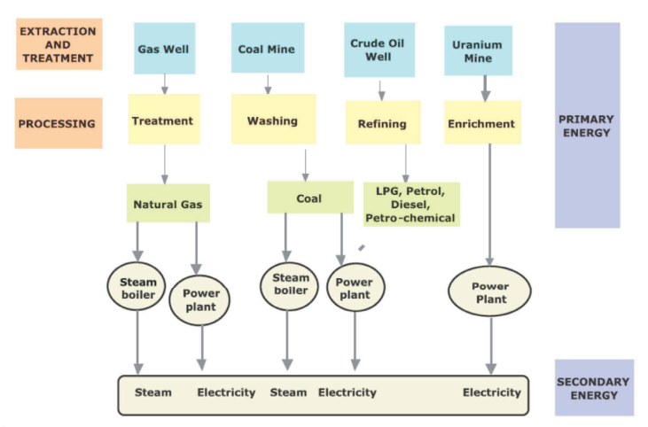
Flow of Energy
Treatment – Sulfur
Washing – Sulfur, Ash and Slag
Refining – Extract different types of oil
Enrichment - Increasing the percentage of Uranium-235

Slide 9
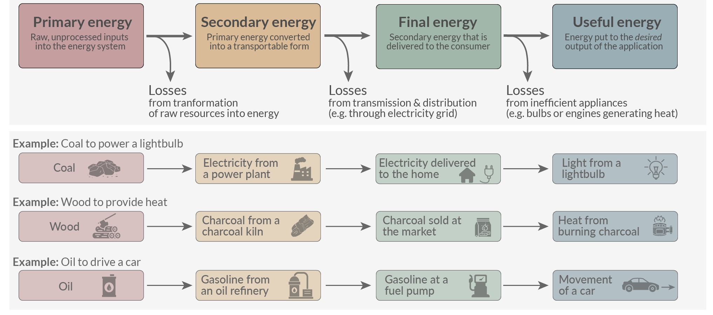
Flow of Energy

Slide 10
Energy Audit
“The verification, monitoring and analysis of use of energy including submission of technical report containing recommendations for improving energy efficiency with cost benefit analysis and an action plan to reduce energy consumption“
Energy Conservation Act 2001
A study of a plant or facility to determine how and where energy is used and identify methods for energy savings
The key to a systematic approach for decision-making in the area of energy management
Translation of energy conservation ideas into realities
Energy, Material and Labor – highest potential for cost reduction and thereby increasing the profit

Slide 11
Types of Energy Audit
Energy audit type depends on
Function and type of industry
Depth to which final audit is needed
Potential and magnitude of cost reduction desired
Energy audit can be classified into
Preliminary audit
Targeted audit
Detailed audit

Slide 12
Preliminary Energy Audit
Set up a baseline / reference for the energy consumption from past data and identify the scope for energy savings
Identify immediate (especially no-/low-cost) improvements/ savings
Identify areas for more detailed study/ measurement

Slide 13
Preliminary Energy Audit Outcomes
No cost
Arresting leaks (steam, compressed air)
Controlling excess air by adjusting fan damper
Low cost
Shutting equipment when not needed
Replacement with appropriate items/ retrofit like lamps, motion sensors
Areas for detailed audit
Upgrading or installing new insulation or equipment (e.g., heat pump based heating, High eff. heat exchanger)
Modifying the process
Scheduling of operation
Waste heat recovery

Slide 14
Energy use analysis
 | Electricity, kWh | Fuel, kg | LPG, kg | Diesel, kg | Total, MWh
January | 2943374 | 93919 | 2498 | 1650 | 4070.888
February | 2453916 | 109077 | 2703 | 1650 | 3757.738
March | 3054064 | 129540 | 3700 | 1650 | 4605.024
April | 2914539 | 117146 | 4064 | 1100 | 4321.558
May | 3082023 | 122894 | 4139 | 0 | 4542.829
June | 2852936 | 130902 | 4446 | 0 | 4409.404
July | 3313587 | 128429 | 4120 | 880 | 4848.012
August | 2985654 | 117961 | 3747 | 0 | 4384.962
September | 3047247 | 123566 | 4707 | 0 | 4522.951
August | 2958361 | 128500 | 5024 | 770 | 4503.75
November | 3024284 | 129301 | 4996 | 1650 | 4588.925
December | 3079456 | 148502 | 4642 | 1650 | 4859.656
Total | 35709441 | 1479737 | 48786 | 11000 | 53415.7
Energy use in a manufacturing plant

Slide 15
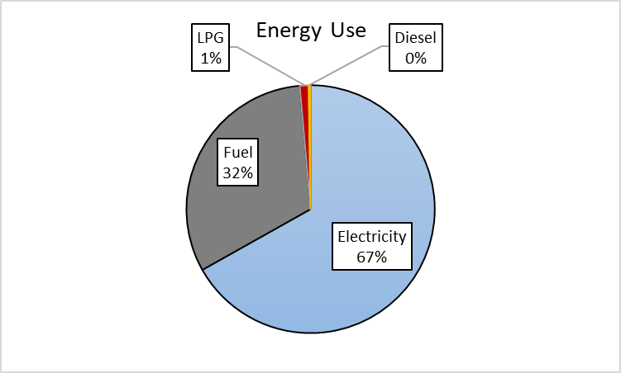
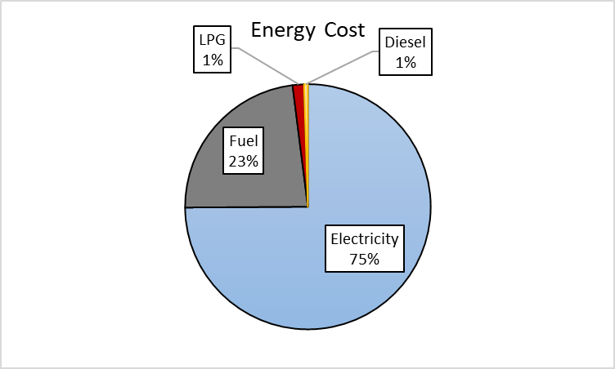
Energy or Cost or Emission?

Slide 16
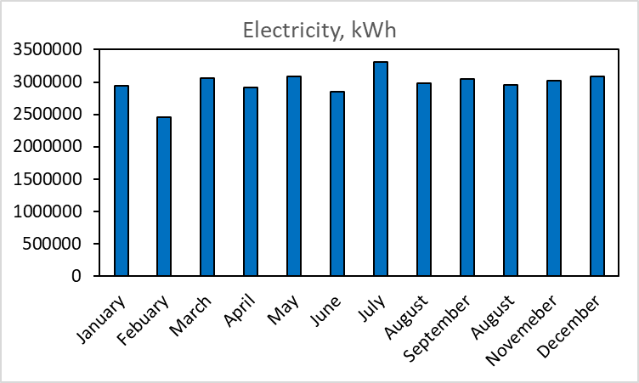
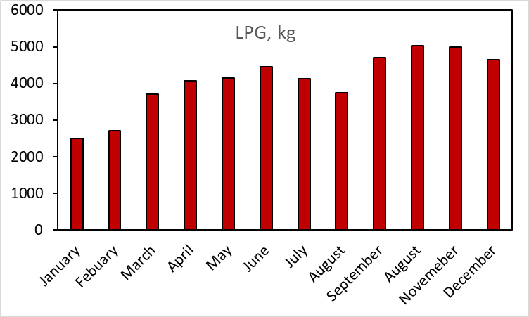
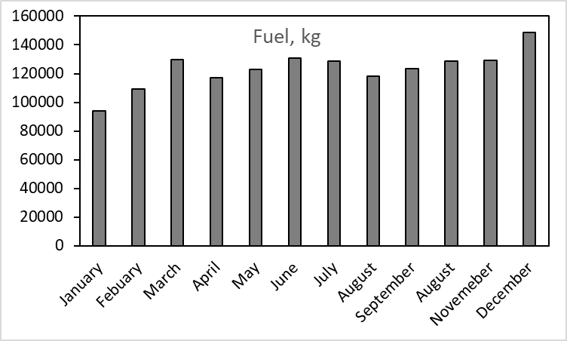
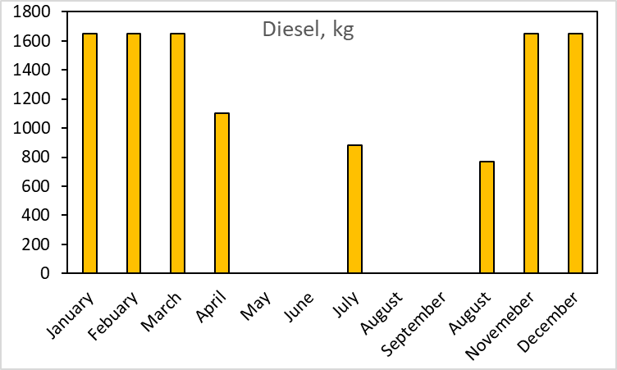
Energy Use and Distribution

Slide 17
Targeted Energy Audit
Often results from preliminary results
Detail survey on the area of changes or modifications (e.g. lighting)
Recommendations reading the outcome in savings (how much savings in energy and cost for the given number and type)

Slide 18
Detailed Energy Audit
A comprehensive audit provides a detailed energy project implementation plan
Offers the most accurate estimate of energy savings and cost
Considers the interactive effects of all projects, accounts for the energy use of all major equipment
Includes detailed energy cost saving calculations and project cost
Steps for conducting detailed audit
Phase I – pre audit phase
Phase II – audit phase
Phase III – post audit phase

Slide 19
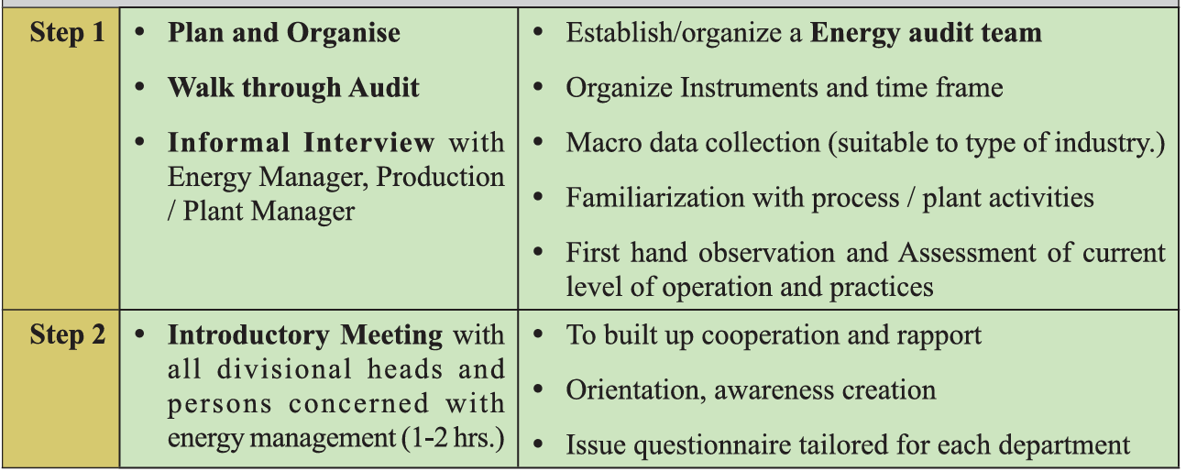
Pre Audit Phase

Slide 20
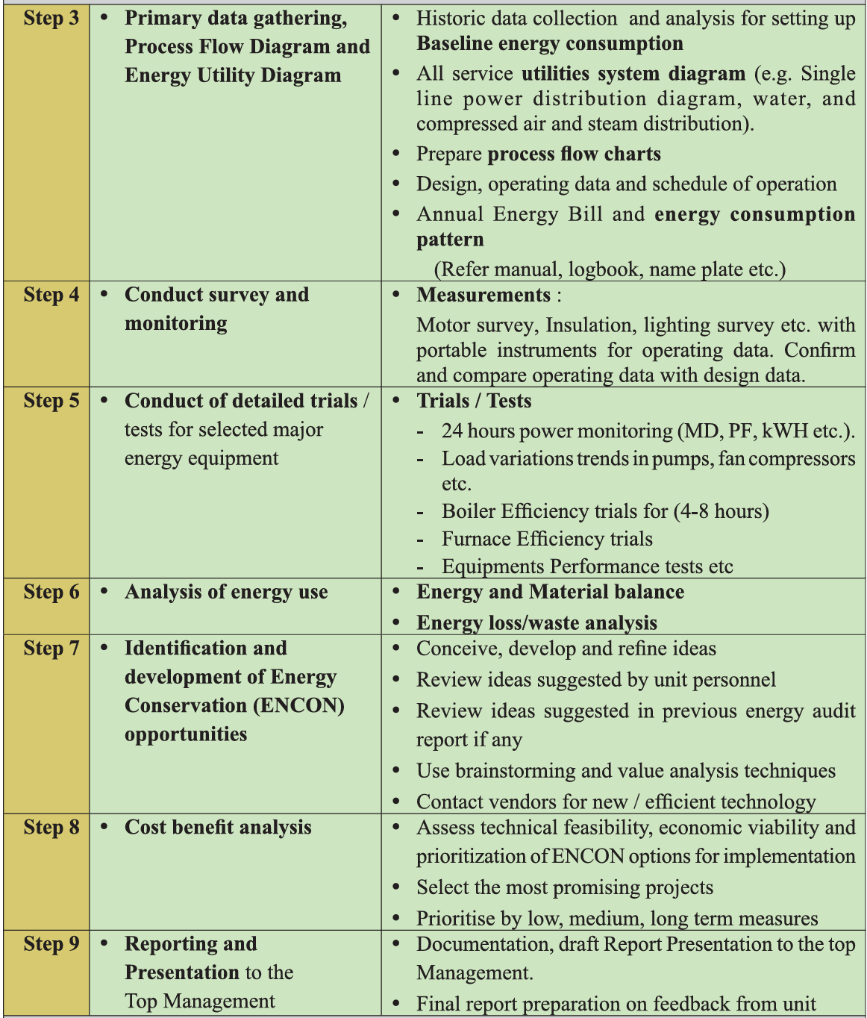
Audit Phase

Slide 21
Audit Phase

Slide 22

Post Audit Phase

Slide 23
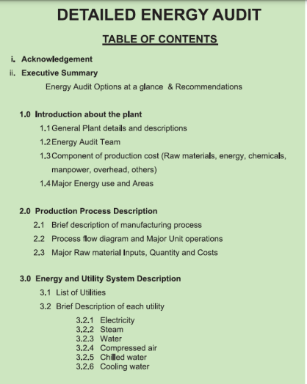
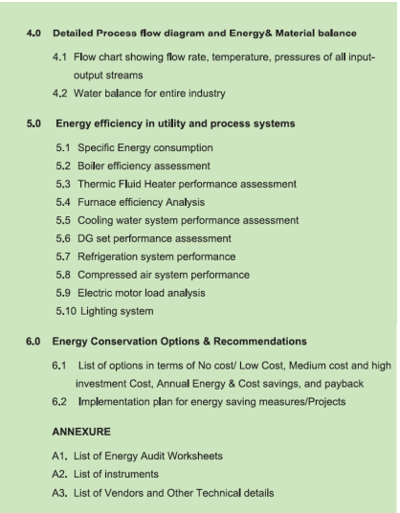
Energy Audit Report

Slide 24
Energy conservation opportunities
Short-term Schemes
Usually involves changes in operating practices with little or no investments
Tightening operation, control and improved house keeping
Use of steam (check for leaks)
Electrical power (avoid the waste)
Medium-term Schemes
Low cost modifications and improvements
Insulation
Power factor
Equipment operational modifications and improvements
Long-term Schemes
Modifications involving high capital investments
Equipment upgradation
Heat recovery
Process modifications

Slide 25
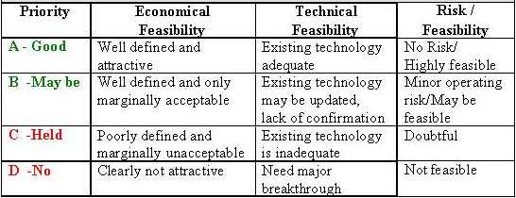
Selection of Long-term Measures
A - Attractive
B and C – For fixed target

Slide 26
Equipment Data Collection
Consumption of fuel, steam, electricity, compressed air, cooling water, chilled water…..
Energy costs
Quantity of raw materials, intermediate and final products as well as waste products
Capacity utilization
Efficiency trends of process, equipment
It is important to plan additional data gathering carefully (at least for 3 years)
……Many more……

Slide 27
Utility Data Collection – E.g. Steam
At each process / stage of operation
Boiler capacities
Steam conditions
Normal operating load (T/h)
Maximum load (T/h)
Steam requirements at different pressures
Captive generation – Yes/No (if yes provide ratings, fuel, average output)
Cogeneration – Yes/No (if yes provide ratings, fuel, average output)

Slide 28
References
https://www.123rf.com/clipart-vector/energy_conservation_charts.html
https://ourworldindata.org/energy-definitions
Accelerating Improvements in the Energy Efficiency of Room Air Conditioners (RACs) in India: Potential, Cost-Benefit, and Policies (Interim Assessment) by Nikit Abhyankar, Nihar Shah, Won Young Park and Amol Phadke
Energy Efficiency: Concepts and Calculations by Daniel M. Martínez, Ben W. Ebenhack and Travis P. Wagner

